Slide 1
RECURSIVE AND NON -RECURSIVE ALGORITHMS
LECTURE TWO

Slide 2
RECURSIVE ALGORITHMS
A recursive algorithm solves a problem by breaking it into smaller, similar subproblems and solving each subproblem by calling itself.
Each recursive call works on a reduced input until a base case is reached, which provides a direct solution without further recursion.
The solutions to subproblems are then combined to solve the original problem.

Slide 3
KEY CHARACTERISTICS OF RECURSIVE ALGORITHMS
Base Case: A condition that stops recursion by returning a direct result (e.g., for factorial, 𝑛≤1n≤1 returns 1).
Recursive Case: The part where the function calls itself with a smaller input (e.g., 𝑛!=𝑛×(𝑛−1)!n!=n×(n−1)!).
Call Stack: Recursive calls are managed by the system’s call stack, which stores the state of each call (parameters, local variables, return address).
Divide-and-Conquer: Many recursive algorithms (e.g., merge sort, quicksort) divide the problem into smaller parts, solve them recursively, and combine results.

Slide 4
ADVANTAGES OF RECURSIVE ALGORITHMS
Elegant and concise for problems with a natural recursive structure (e.g., tree traversals, divide-and-conquer).
Intuitive for problems where the solution depends on smaller instances of the same problem.
Easy to implement for complex problems like graph algorithms or backtracking
Reduced Time Complexity:
Efficient Tree Traversal:
Improved Readability:
allows breaking down large problems into smaller:

Slide 5
DISADVANTAGES OF RECURSIVE ALGORITHMS
Can be memory-intensive due to the call stack (𝑂(𝑛)O(n) space for deep recursion).
Risk of stack overflow for large inputs.
May have higher overhead due to repeated function calls compared to iterative solutions.
Recursion can be confusing for large problems.

Slide 6
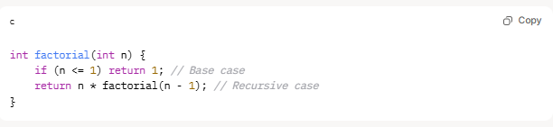
EXAMPLE OF RECURSIVE FACTORIAL ALGORITHM
The factorial of a number 𝑛, denoted 𝑛!, is the product of all positive integers up to 𝑛. For example, 5!=5×4×3×2×1=120.

Slide 7
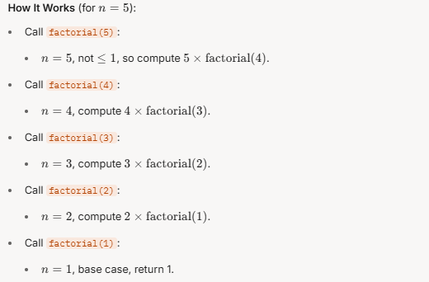
EXAMPLE OF RECURSIVE FACTORIAL ALGORITHM

Slide 8
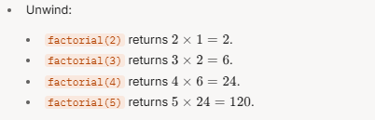
EXAMPLE OF RECURSIVE FACTORIAL ALGORITHM

Slide 9
MATHEMATICAL ANALYSIS OF RECURSIVE ALGORITHMS
The goal is to quantify the algorithm’s time complexity (number of operations) and space complexity (memory usage) as a function of the input size 𝑛.
Recursive algorithms are typically analyzed using recurrence relations, which describe the cost of the algorithm in terms of its recursive calls and base cases.

Slide 10
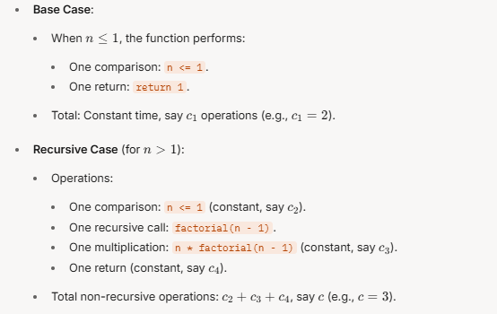
TIME COMPLEXITY ANALYSIS
Time complexity measures the total number of basic operations (e.g., comparisons, multiplications, function calls) performed.
STEP-BY-STEP BREAKDOWN

Slide 11
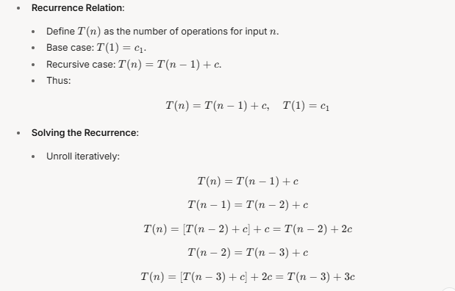
TIME COMPLEXITY ANALYSIS

Slide 12
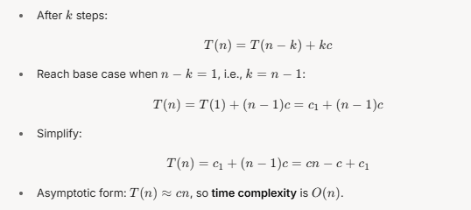
TIME COMPLEXITY ANALYSIS

Slide 13
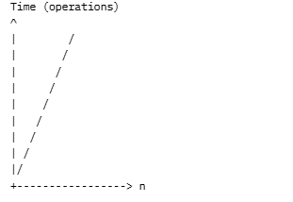
GRAPH FOR TIME COMPLEXITY ANALYSIS
The linear slope reflects 𝑂(𝑛)O(n) growth.

Slide 14
SPACE COMPLEXITY ANALYSIS
Space complexity measures memory usage, primarily from the call stack.
Call Stack:
Each recursive call adds a stack frame, storing:
Parameter 𝑛n (constant space, e.g., 4 bytes).
Return address and bookkeeping (constant space).
Maximum depth: 𝑛n calls (e.g., for 𝑛=5, stack holds factorial(5), factorial(4), ..., factorial(1)).
Each frame uses constant space, say 𝑠s bytes.

Slide 15
SPACE COMPLEXITY ANALYSIS
Total Memory:
𝑛frames, each using 𝑠 bytes.
Total: 𝑛×𝑠, so space complexity is 𝑂(𝑛).
No Auxiliary Structures:
The algorithm uses only the call stack, with no additional arrays or variables.

Slide 16
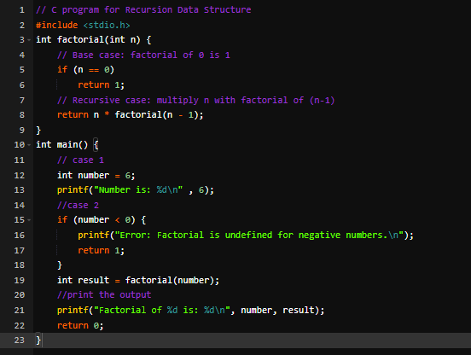
FOLLOWING ARE THE IMPLEMENTATIONS OF THE RECURSION

Slide 17
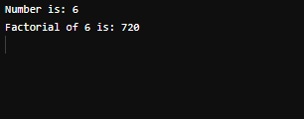
EXAMPLE OF RECURSIVE

Slide 18
NON-RECURSIVE ALGORITHM
A non-recursive algorithm (or iterative algorithm) solves a problem using iterative constructs like loops (for, while, etc.) or other control structures, without calling itself.
Unlike recursive algorithms, which break problems into smaller subproblems via function calls, non-recursive algorithms process the problem directly, often maintaining state through variables or data structures.

Slide 19
NON-RECURSIVE ALGORITHM
KEY CHARACTERISTICS:
Uses loops or iteration instead of function self-calls.
Typically avoids the call stack, leading to lower memory usage.
Often more efficient for large inputs due to reduced overhead.
May require explicit data structures (e.g., stacks or queues) to mimic recursive behavior for complex problems.

Slide 20
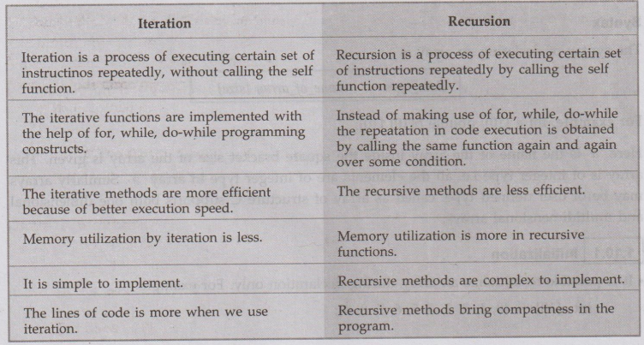
COMPARISON WITH RECURSIVE ALGORITHMS
Recursive: Elegant for problems with natural recursive structure (e.g., tree traversals, divide-and-conquer). Uses call stack, which can lead to 𝑂(𝑛) space complexity for deep recursion.
Non-Recursive: More memory-efficient (often 𝑂(1) or 𝑂(𝑛) space, depending on auxiliary structures). May be less intuitive for some problems but avoids stack overflow.

Slide 21
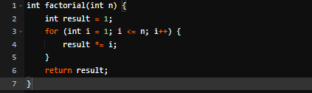
Example: Non-recursive factorial algorithm
Let’s revisit the iterative factorial algorithm to illustrate a non-recursive algorithm, analyze it mathematically, and compare it to its recursive counterpart.
This computes 𝑛!n! (e.g., 5!=5×4×3×2×1=1205!=5×4×3×2×1=120) by iteratively multiplying numbers from 1 to 𝑛n.

Slide 22
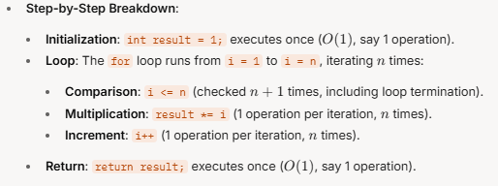
MATHEMATICAL ANALYSIS OF NON-RECURSIVE FACTORIAL
We’ll analyze the time complexity and space complexity to quantify performance.
TIME COMPLEXITY ANALYSIS
Time complexity measures the number of basic operations (e.g., assignments, comparisons, multiplications) as a function of input 𝑛.

Slide 23
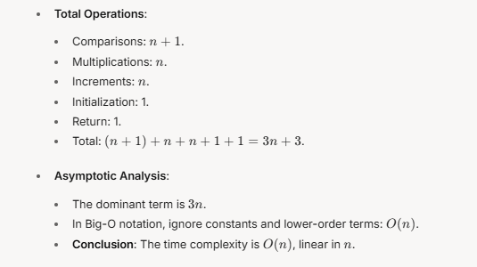
TIME COMPLEXITY ANALYSIS

Slide 24
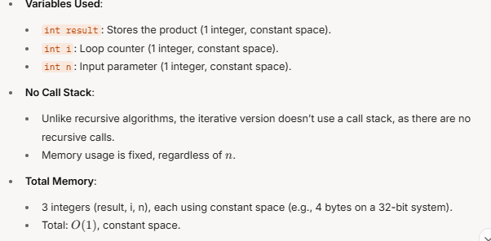
SPACE COMPLEXITY ANALYSIS
Space complexity measures the memory used, excluding the input.

Slide 25
CONVERTING RECURSIVE ALGORITHMS TO NON-RECURSIVE
Many recursive algorithms can be rewritten as non-recursive by replacing the call stack with explicit data structures (e.g., stacks, queues) or loops.
GENERAL CONVERSION PROCESS
Identify the Recursive Structure:
Determine the base case(s) and recursive case(s).
Understand how the call stack manages state (parameters, return values).
Replace Recursion with Iteration:
Use a loop to process the problem iteratively.
Maintain state using variables or data structures (e.g., a stack for depth-first traversal).

Slide 26
CONVERTING RECURSIVE ALGORITHMS TO NON-RECURSIVE
Handle the Call Stack Explicitly (if needed):
For algorithms with complex recursion (e.g., tree traversals), use a stack or queue to mimic the recursive call stack.
Push parameters onto the stack for each “call” and pop them to process.
Optimize for Space:
Minimize auxiliary space (e.g., use loop variables).
Avoid redundant computations.

Slide 27
Example: Recursive to Non-Recursive Binary Tree Preorder Traversal
Recursive algorithms for tree traversals (e.g., preorder: root, left, right) are common but can be converted to non-recursive forms using a stack.

Slide 28
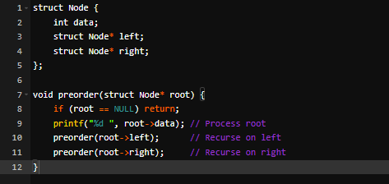
CONVERTING RECURSIVE ALGORITHMS TO NON-RECURSIVE

Slide 29
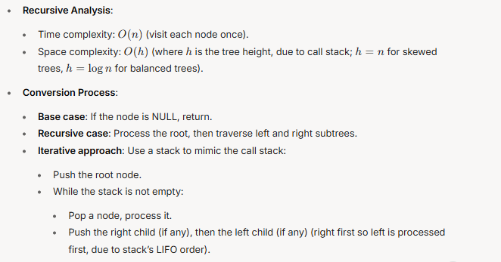
Example: Recursive to Non-Recursive Binary Tree Preorder Traversal

Slide 30
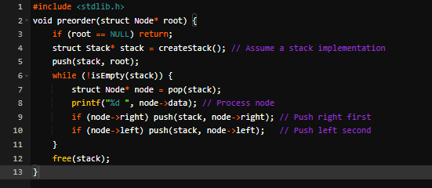
Non-Recursive Binary Tree Preorder Traversal

Slide 31
Non-Recursive Binary Tree Preorder Traversal
Analysis:
Time complexity: 𝑂(𝑛)(each node is pushed and popped once).
Space complexity: 𝑂(ℎ) (stack stores at most ℎ nodes, where ℎ is the tree height).
Why It Works: The stack explicitly mimics the recursive call stack, storing nodes in the order they would be processed recursively.

Slide 32
ADVANTAGES OF NON-RECURSIVE ALGORITHMS
Memory Efficiency:
Avoids call stack overhead, reducing space complexity (e.g., 𝑂(1) for factorial vs. 𝑂(𝑛) recursive).
Prevents stack overflow for large inputs.
Performance:
Eliminates function call overhead, often making iterative algorithms faster.
Example: Iterative factorial has lower constant factors than recursive.
Scalability:
Suitable for large inputs where recursion might cause stack overflow.
Control:
Easier to modify or debug in some cases, as state is explicit (e.g., loop variables or stacks)

Slide 33
CHALLENGES (disadvantages) OF NON-RECURSIVE ALGORITHMS
Complexity:
For problems like tree traversals or divide-and-conquer (e.g., quicksort), iterative versions may require explicit stacks or queues, making code less intuitive.
Example: Iterative preorder traversal is more complex than recursive.
Readability (sometimes readability is hard ):
Recursive solutions are often more simple for problems with natural recursive structure (e.g., Fibonacci, merge sort).Auxiliary
Space:
While iterative algorithms often save stack space, complex conversions (e.g., tree traversals) may still require 𝑂(𝑛) or 𝑂(ℎ) space for explicit stacks.

Slide 34
FIBONACCI SEQUENCE
The Fibonacci sequence is a series of numbers where each number is the sum of the two preceding(previous ) ones, starting with 0 and 1.
Mathematically:
𝐹(0)=0
𝐹(1)=1
𝐹(𝑛)=𝐹(𝑛−1)+𝐹(𝑛−2) for 𝑛≥2
Sequence: 0, 1, 1, 2, 3, 5, 8, 13, 21, 34, ...
Example:
𝐹(5)=𝐹(4)+𝐹(3)=3+2=5
𝐹(6)=𝐹(5)+𝐹(4)=5+3=8

Slide 35

RECURSIVE FIBONACCI ALGORITHM
The recursive approach directly implements the mathematical definition by calling the function for 𝑛−1 and 𝑛−2

Slide 36
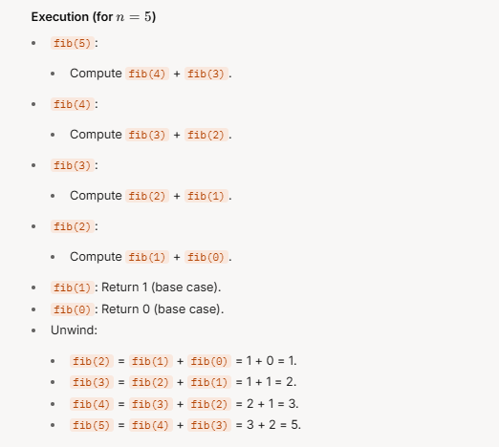
FIBONACCI RECURSIVE ALGORITHM

Slide 37
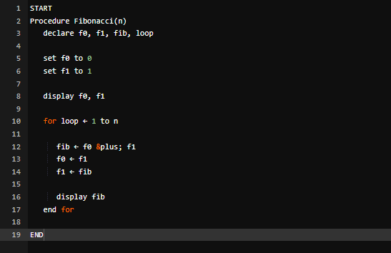
FIBONACCI RECURSIVE ALGORITHM

Slide 38
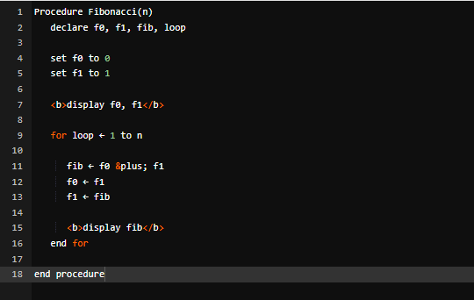
FIBONACCI ITERATIVE ALGORITHM

Slide 39
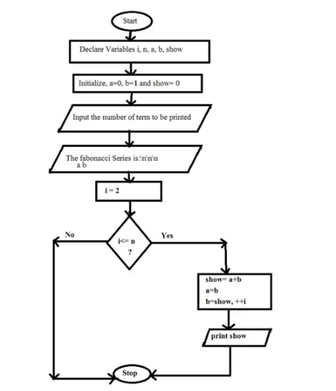
FIBONACCI FLOWCHART

Slide 40
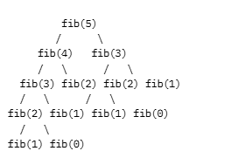
RECURSION TREE
Many nodes (e.g., fib(2)) are computed multiple times, leading to redundancy.

Slide 41
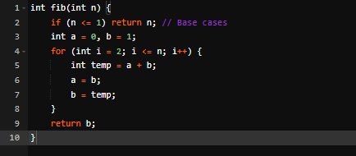
NON-RECURSIVE FIBONACCI ALGORITHM
The non-recursive (iterative) approach computes Fibonacci numbers using a loop, storing intermediate results in variables to avoid redundant calculations.

Slide 42
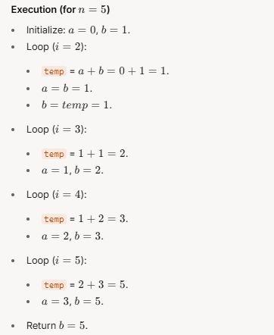
NON-RECURSIVE FIBONACCI ALGORITHM

Slide 43
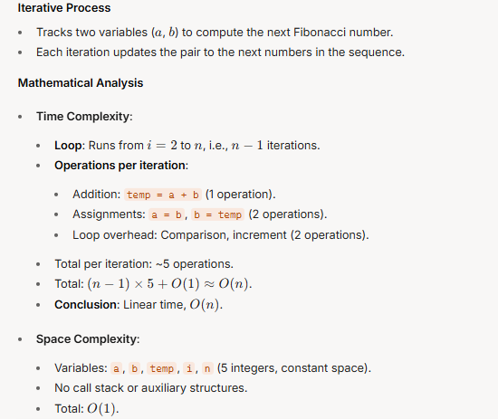
NON-RECURSIVE FIBONACCI ALGORITHM

Slide 44
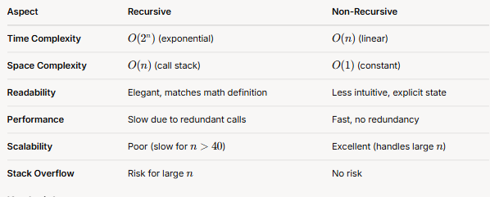
RECURSIVE VS. NON-RECURSIVE FIBONACCI

Slide 45
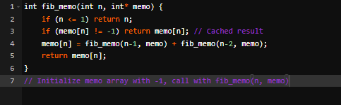
OPTIMIZING RECURSIVE FIBONACCI
The recursive Fibonacci algorithm’s exponential time complexity can be improved using memorization, dynamic programming or Tail Recursion.
Memoized Recursive Fibonacci
Cache results to avoid recomputing fib(n) for the same 𝑛.

Slide 46
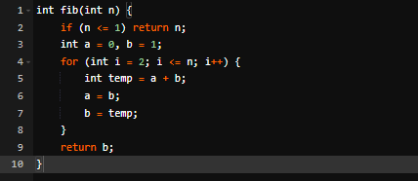
OPTIMIZING RECURSIVE FIBONACCI
Dynamic Programming (Bottom-Up)
Iterative approach (same as non-recursive above) is a form of dynamic programming, computing Fibonacci numbers from the bottom up.

Slide 47

OPTIMIZING RECURSIVE FIBONACCI
Tail Recursion
Rewrite the algorithm so the recursive call is the last operation, allowing compilers (in some languages) to optimize stack usage

Slide 48
EMPIRICAL ANALYSIS OF ALGORITHMS
Empirical analysis of algorithms involves evaluating their performance by testing them on real-world inputs and measuring their execution time or resource consumption.
This approach contrasts with theoretical analysis, which uses mathematical models and assumptions.
Empirical analysis provides concrete data on how an algorithm performs in practice, helping identify its strengths, weaknesses, and potential issues.

Slide 49
KEY ASPECT OF EMPIRICAL ANALYSIS OF ALGORITHMS
Practical Testing:
Unlike theoretical analysis, which focuses on abstract models, empirical analysis involves running the algorithm on a computer with specific inputs and measuring its performance.
Observing Real-World Behavior:
It provides insights into how an algorithm performs with real-world data, including the effects of factors like hardware, implementation details, and data characteristics.
Identifying Strengths and Weaknesses:
By analyzing performance data, you can identify which algorithms are most efficient for certain tasks, and which have limitations or potential bottlenecks.

Slide 50
KEY ASPECT OF EMPIRICAL ANALYSIS OF ALGORITHMS
Benchmarking and Comparison:
Empirical analysis is often used to compare different algorithms or different implementations of the same algorithm, allowing you to choose the best option for a specific application.
Data-Driven Approach:
Empirical analysis relies on collecting and analyzing data, providing a more concrete understanding of algorithm behavior than theoretical predictions alone

Slide 51
STEPS IN EMPIRICAL ANALYSIS OF ALGORITHMS
Define Performance Metrics:
Determine what aspects of the algorithm's performance you want to measure (e.g., execution time, memory usage, number of operations).
Choose Representative Inputs:
Select a set of inputs that are representative of the range of data the algorithm will be used with in practice.
Implement the Algorithm:
Implement the algorithm in a programming language and on a specific computer or platform.

Slide 52
STEPS IN EMPIRICAL ANALYSIS OF ALGORITHMS
Run Experiments:
Run the algorithm on the chosen inputs and measure its performance using the defined metrics.
Analyze Results:
Analyze the data collected to identify trends, patterns, and insights into the algorithm's performance.
Draw Conclusions:
Based on the analysis, draw conclusions about the algorithm's strengths, weaknesses, and suitability for the intended application

Slide 53
BENEFITS OF EMPIRICAL ANALYSIS OF ALGORITHMS
Practical Performance Insights:
Provides concrete data on how an algorithm behaves in real-world scenarios.
Identification of Bottlenecks:
Helps pinpoint areas where the algorithm might be inefficient or slow.
Comparison of Algorithms:
Allows for a direct comparison of different algorithms under similar conditions.
Optimization:
Can guide improvements to the algorithm or its implementation to achieve better performance.

Slide 54
LIMITATIONS OF EMPIRICAL ANALYSIS OF ALGORITHMS
Limited Generalization: Results may not be generalizable to all possible inputs or environments.
Dependency on Implementation: Performance can be affected by implementation details, making it difficult to compare different algorithms fairly.
Computational Cost: Running experiments and analyzing data can be time-consuming and resource-intensiv

Slide 55
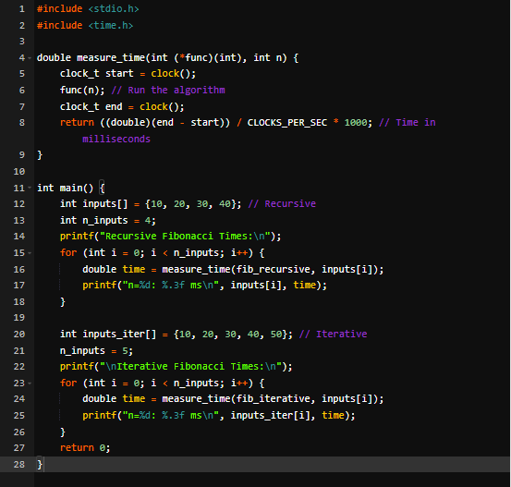
EXAMPLE FOR MEASUREMENT

Slide 56
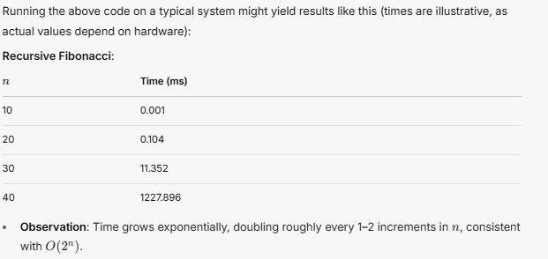
RESULTS FOR MEASUREMENT

Slide 57
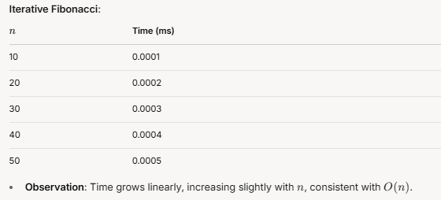
RESULTS FOR MEASUREMENT

Slide 58
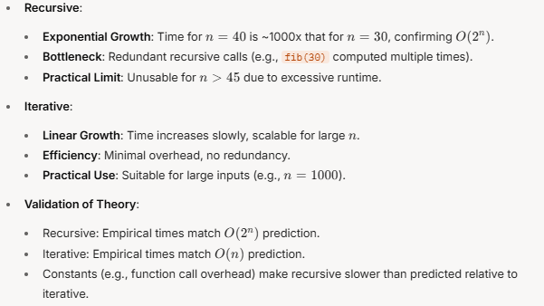
ANALYZE OF RESULTS

